Slide 1
Data-Driven Financial Strategies
Big Mountain Ski Resort

Slide 2
Problem

Slide 3
Big Mountain needs an additional
$1,540,000
in annual profits to balance new
and upcoming operating costs.

Slide 4
SOLUTION: 2-PRONG STRATEGY
INCREASE REVENUE
REINVEST IN VALUE
Increase ticket price to match actual market value, as determined by the facilities and prices of other ski resorts around the country.
Reduce or remove facilities which generate the least value, and add or expand on those which generate the most.

Slide 5
Recommendations
Ticket Price
Add Value
Reduce Expense
Current price: $81.00 for each adult weekend ticket.
Future price: Current facilities and attributes would support a ticket price of about $95 ± $10.
Consider adding 1 run and 1 chair lift.
This would support an increased price of $1.99, which equals $3.4 million over the season.
Optionally, close a run that is expensive-to-maintain.
Model shows that closing 1 run has very little impact on potential ticket price. Closing up to 5 reduces that price by ~$1.

Slide 6
Analysis & Modeling

Slide 7
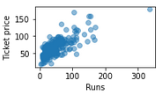
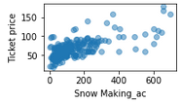
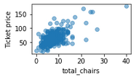
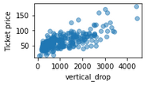
Features Most Correlated with ticket price
Number of Runs
Snow Making Acreage
Number of Chairs
Vertical Drop
Scatterplots showing correlation between adult weekend ticket price and key features.

Slide 8
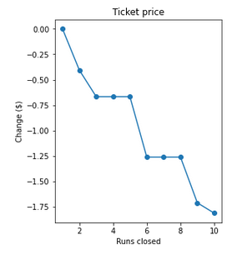
Scenario 1
Permanently closing down up to 10 of the least used runs
Closing 1 run would be a safe change, with very little impact on potential ticket price.
Closing up to 5 reduces the potential price by slightly less than a dollar.
Further closures begin to have substantial impact on the ticket price.
If the operating costs of maintaining those runs is very high, they may be worth closing.

Slide 9
Scenarios 2 & 3
Add 1 run and 1 chair lift, no additional snow coverage
Add 1 run, 1 lift, 2 additional acres of snow coverage
This scenario would support an increased price of $1.99
$3.4 million over the season
If this is enough of an increase to balance the cost of installing and operating the new run and lift, this scenario should be pursued
This scenario returns results identical to scenario 2
Such a small change in snow acreage does not significantly impact the ticket price

Slide 10
Scenario 3
Increase the longest run by 0.2 miles, adding an additional 4 acres of snow coverage
This change has no effect on potential ticket price. It would be an unnecessary expense.
Do not pursue.

Slide 11
SUMMARY
Bug Mountain’s tickets are currently underpriced, and the resort is missing out on a substantial amount of potential revenue. Additionally, there are a number of facility adjustments worth exploring, which would either add value or decrease expense.
The model is available for additional exploration of similar variable adjustments. We can explore what ticket price could be, based on any number of potential resort changes.
What other scenarios would you like to explore?

